Slide 1
Final data for hexagonal lattce

Slide 2
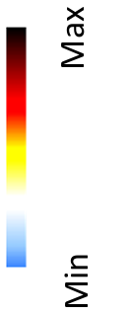







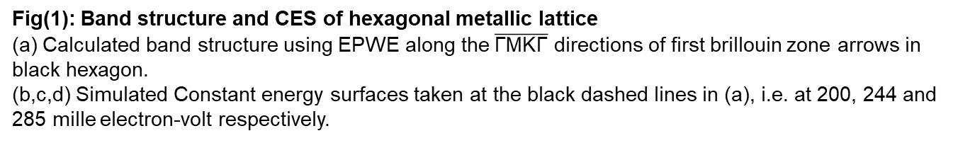
(a)
$$\overline{Γ}$$
$$\overline{M}$$
$$\overline{K}$$
$$\overline{Γ}$$
M
Electron Energy (eV)
Γ
K
$k_{||}$($A^{−1}$)
(b)
200 meV
(c)
244 meV
(d)
285 meV
Fig(1): Band structure and CES of hexagonal metallic lattice (a) Calculated band structure using EPWE along the$\overline{\text{Γ}\text{MK}\text{Γ}}$ directions of first brillouin zone arrows in black hexagon. (b,c,d) Simulated Constant energy surfaces taken at the black dashed lines in (a), i.e. at 200, 244 and 285 mille electron-volt respectively.

Slide 3


(a)
(b)
LDOS at a LDOS at c LDOS at b
b
a
c
(c)
240 meV
(d)
338 meV
Fig(2): LDOS of hexagonal lattice with circular scatters – (a) The local density of states (LDOS) calculated by EPWE for three points in the unit cell, as shown in (b). (c,d) The 2D-LDOS taken at 240 meV and 338 meV.

Slide 4
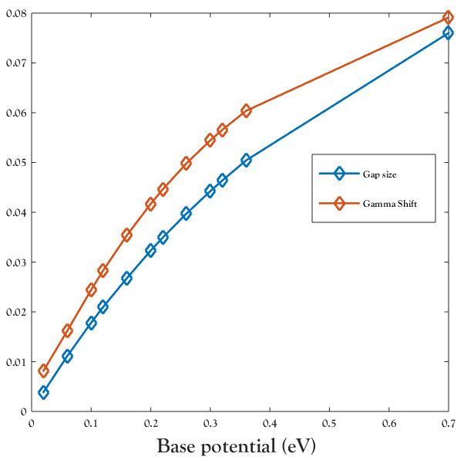




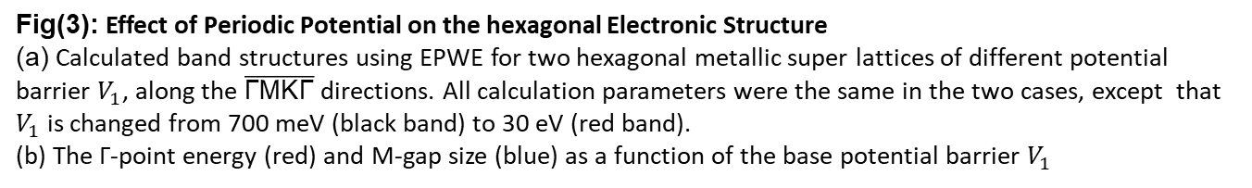

(a)
$$\overline{Γ}$$
$$\overline{M}$$
$$\overline{K}$$
$$\overline{Γ}$$
Electron Energy (eV)
$k_{||}$($A^{−1}$)
Fig(3): Effect of Periodic Potential on the hexagonal Electronic Structure (a) Calculated band structures using EPWE for two hexagonal metallic super lattices of different potential barrier $V_{1}$, along the $\overline{\text{Γ}\text{MK}\text{Γ}}$ directions. All calculation parameters were the same in the two cases, except that $V_{1}$ is changed from 700 meV (black band) to 30 eV (red band). (b) The Γ-point energy (red) and M-gap size (blue) as a function of the base potential barrier $V_{1}$

